Slide 1


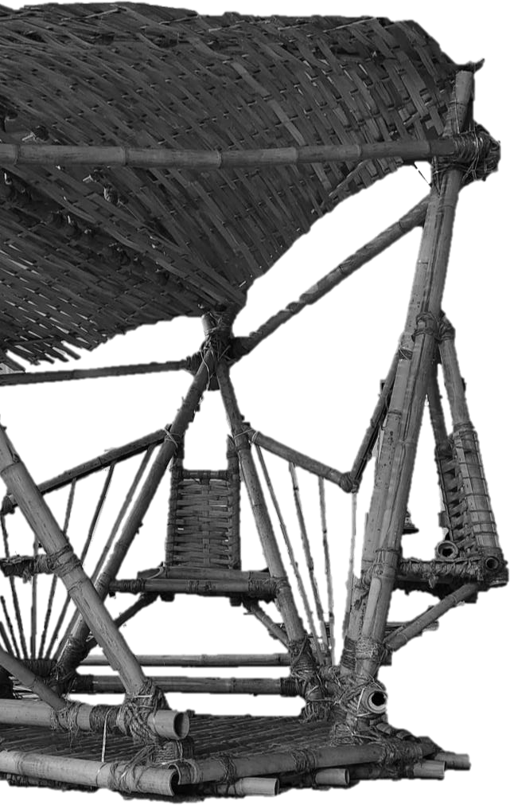
Project 2: Structure and Body: Materials, Anthropometric and Ergonomic Exploration
Activity : Rest (Group 2) Tutor : Ms. Sue May

Slide 2
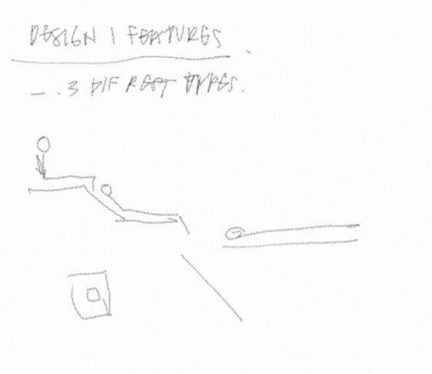
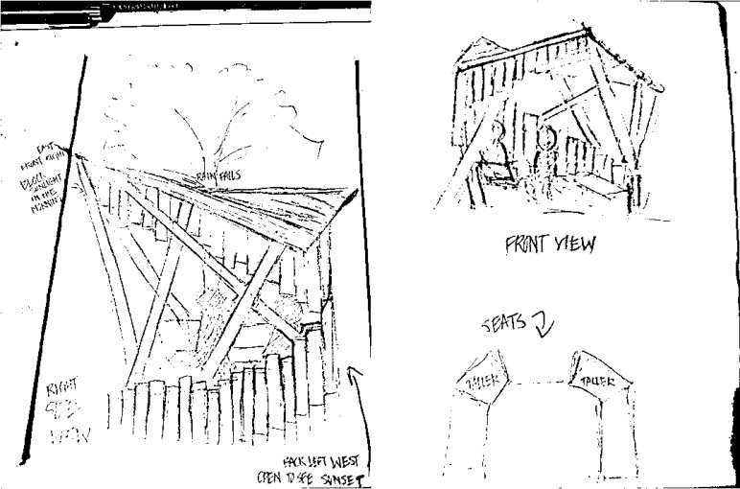
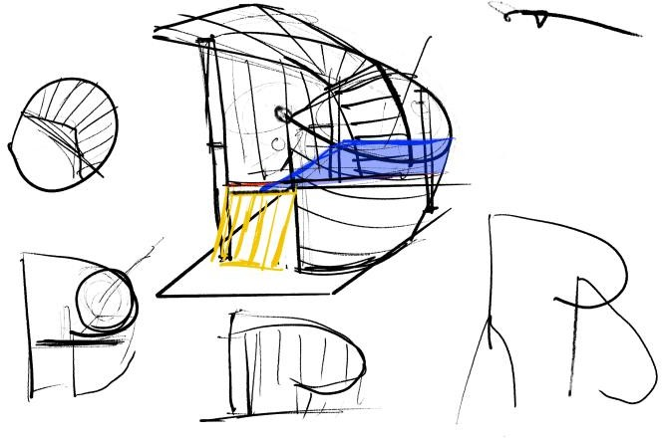
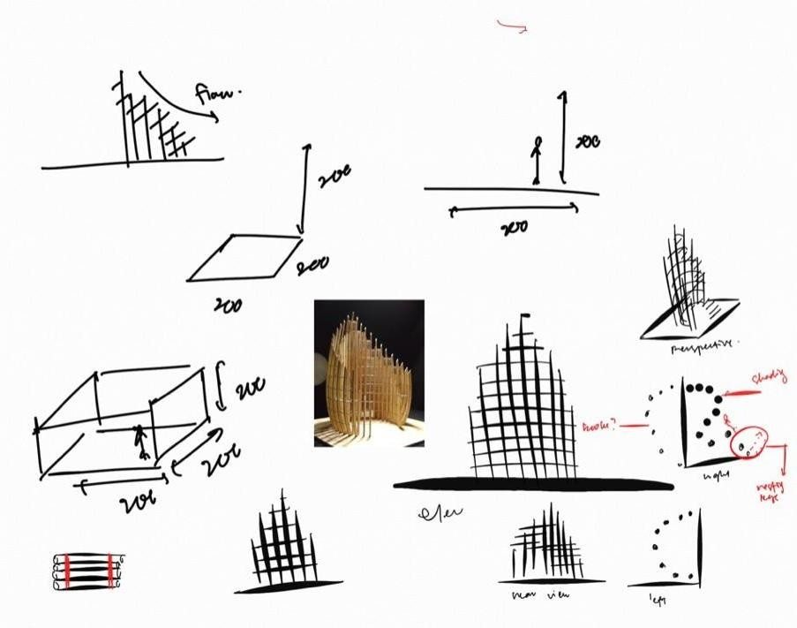
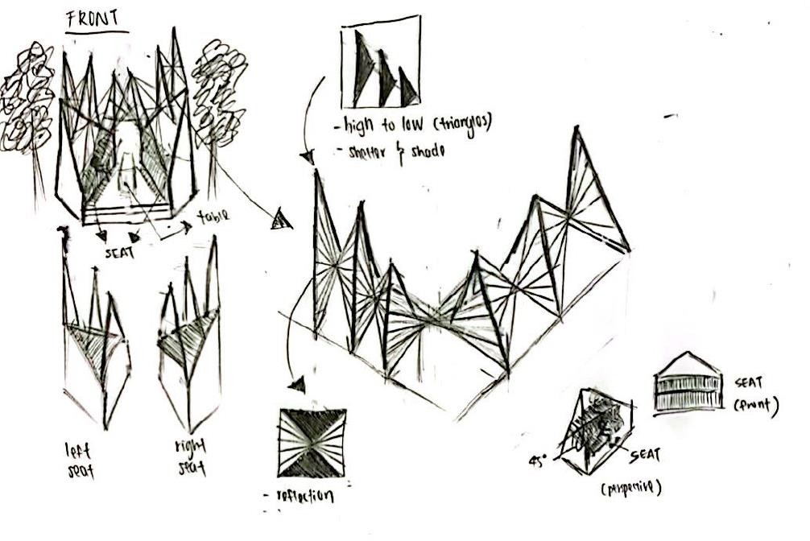
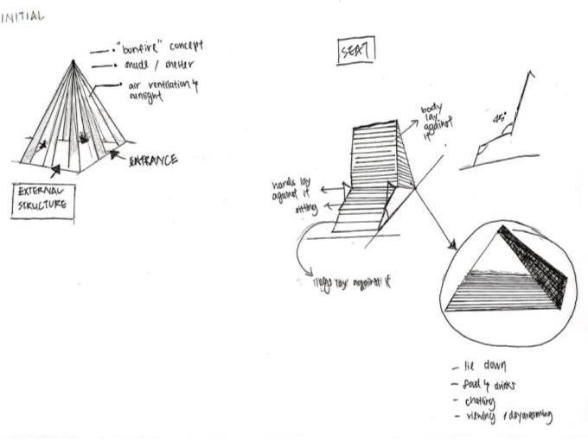
Preliminary Design Sketches
At the beginning of Project 2, to make everyone brainstorm about how a design can function when considering ergonomics and such, they were tasked to create sketch models.

Slide 3
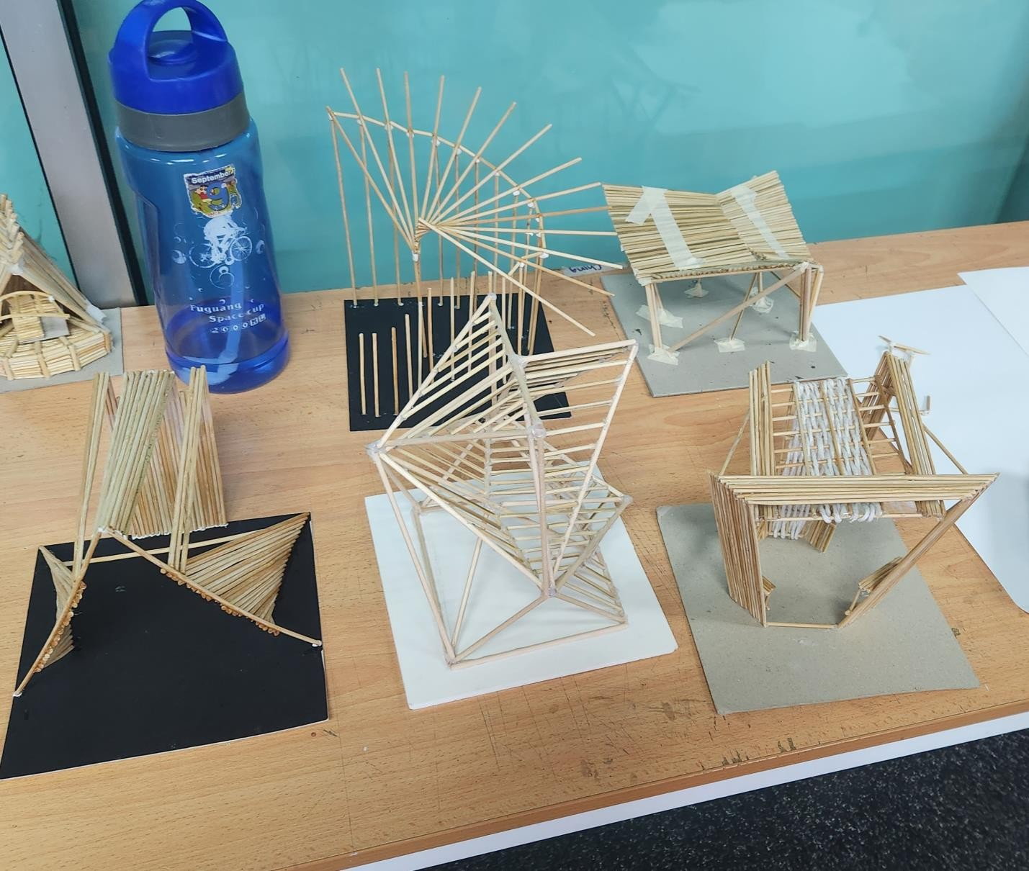
Unfortunately, some of the models are broken, therefore isn’t displayed in the picture.

Slide 4
For the final design, we based it on 2 different mockup models

Slide 5
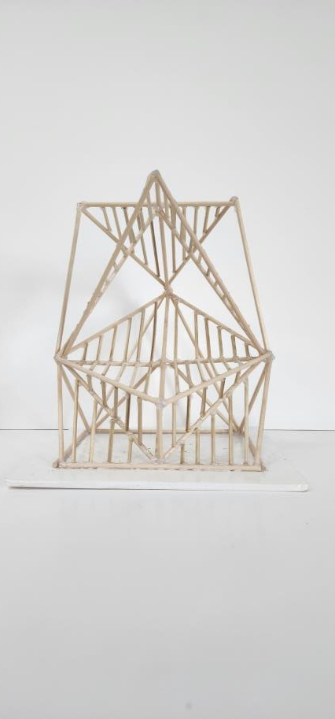
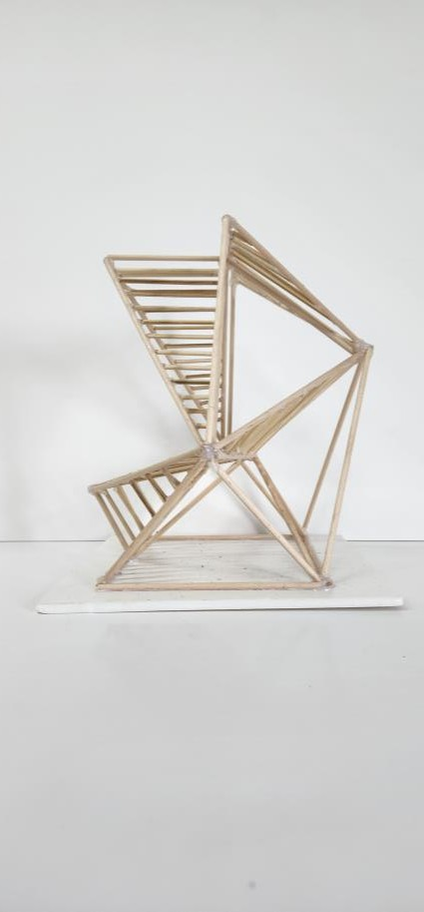
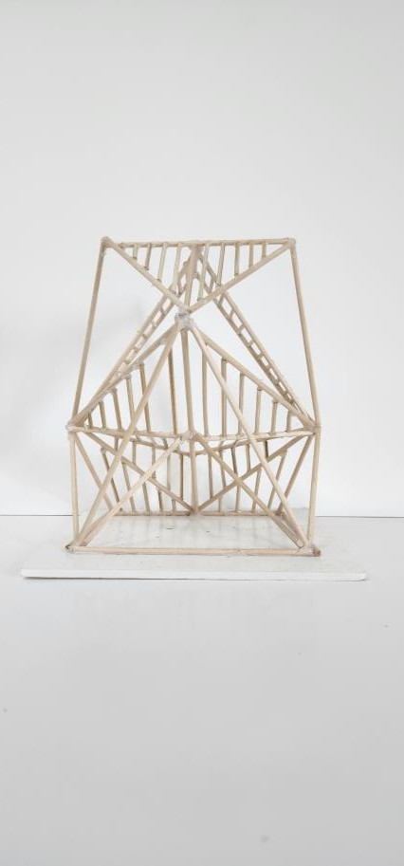
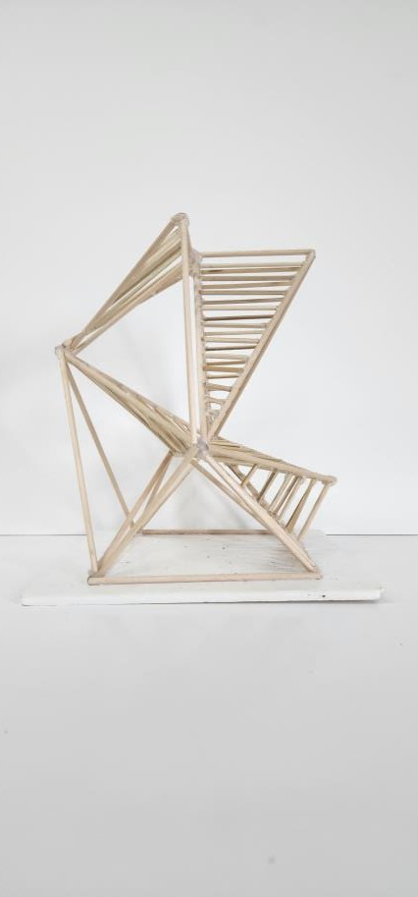
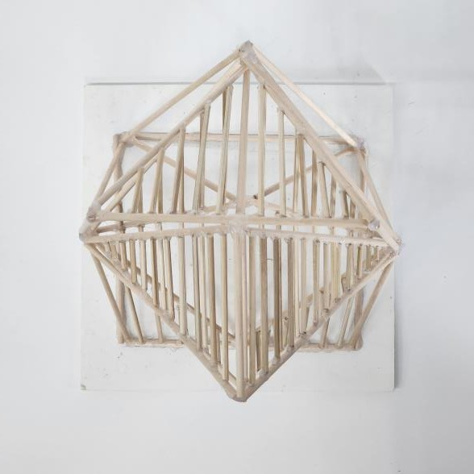
Mockup 1
Top View
Front View
Left View
Rear View
Right View

Slide 6
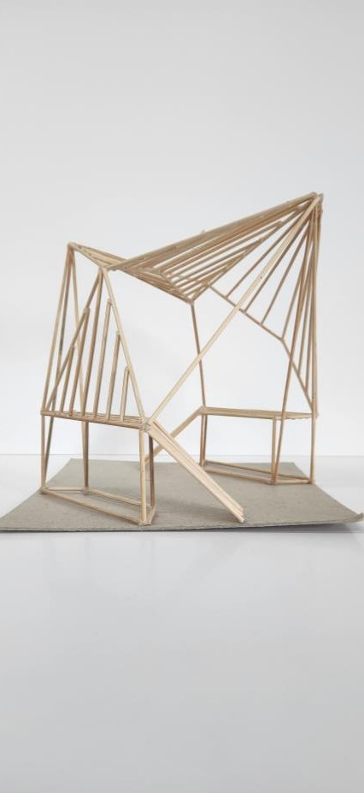
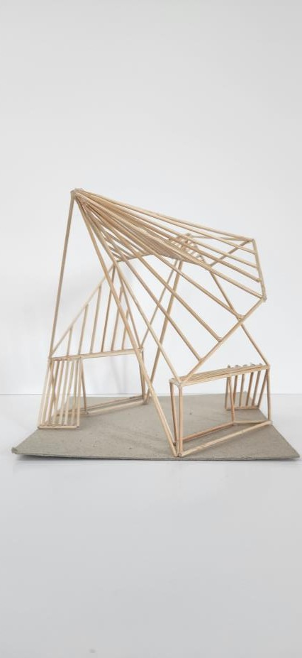
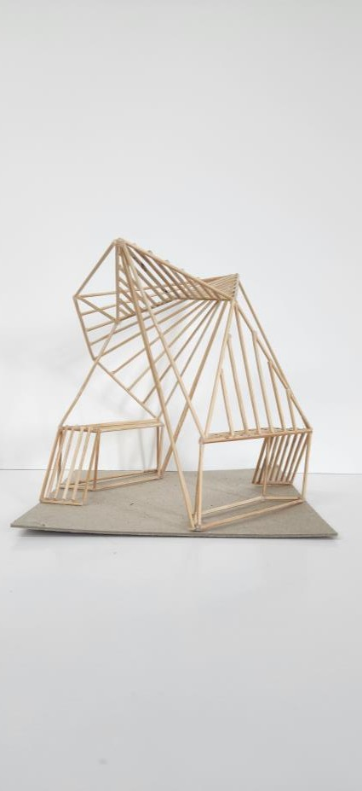
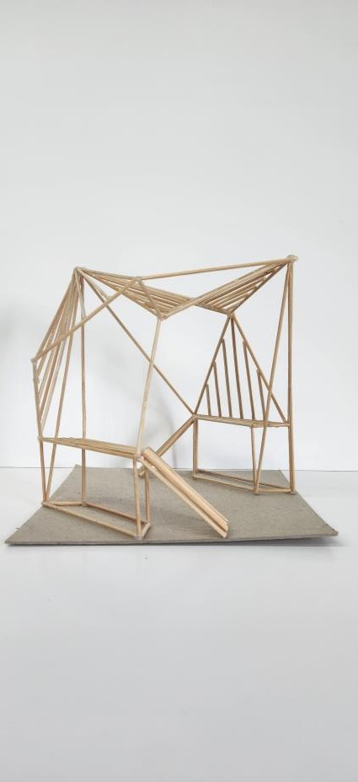
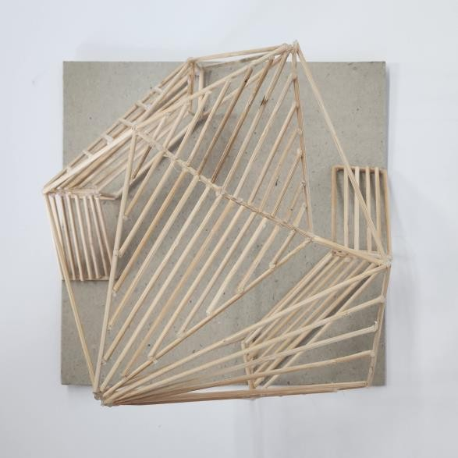
Mockup 2
Top View
Front View
Left View
Rear View
Right View

Slide 7
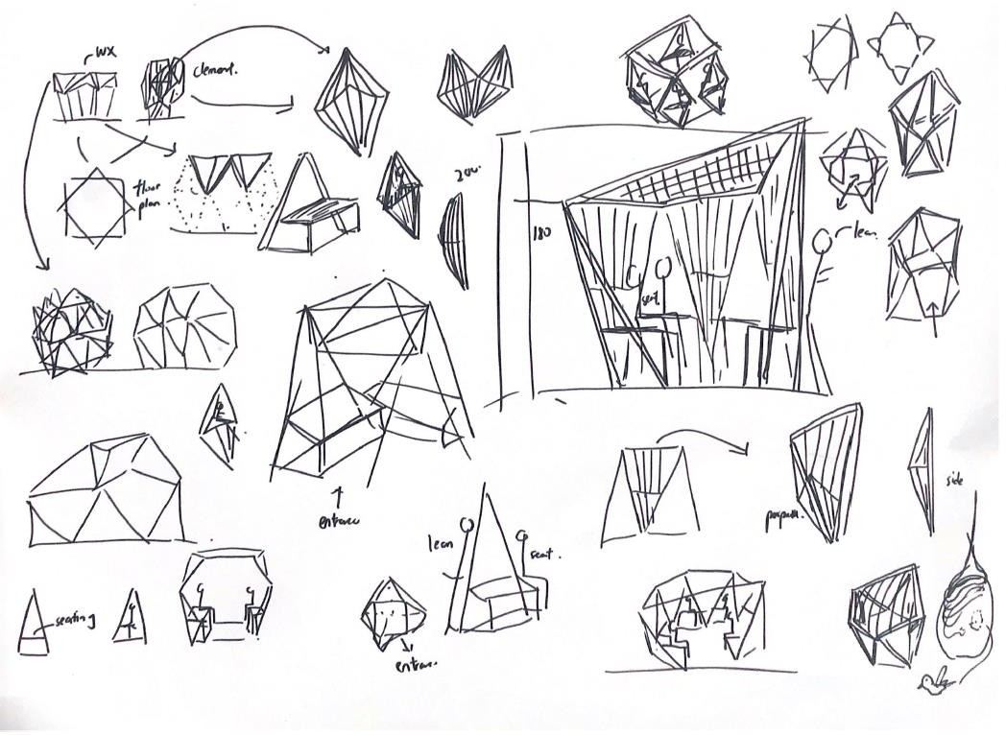
Final Mockup Design Sketches
After examining the 2 mockup models, my team and I created one final design, with considerations of the materiality, tectonics, ergonomics, etc.

Slide 8
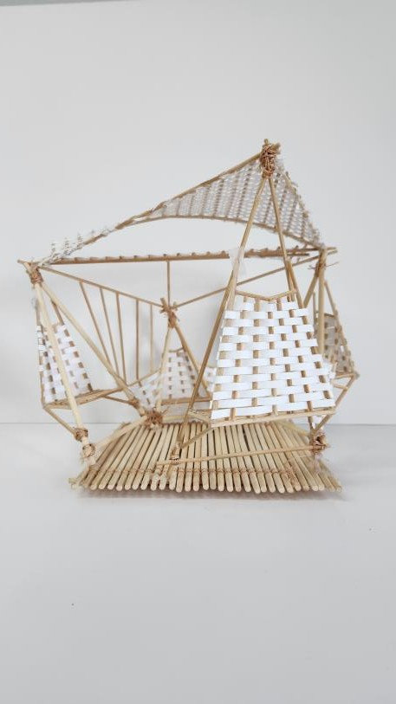
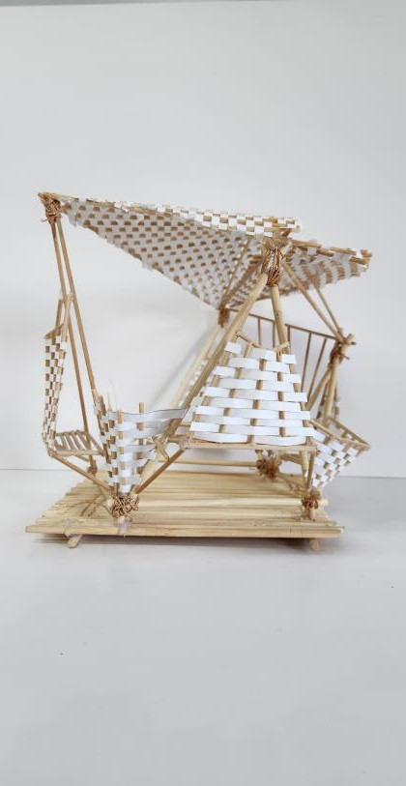
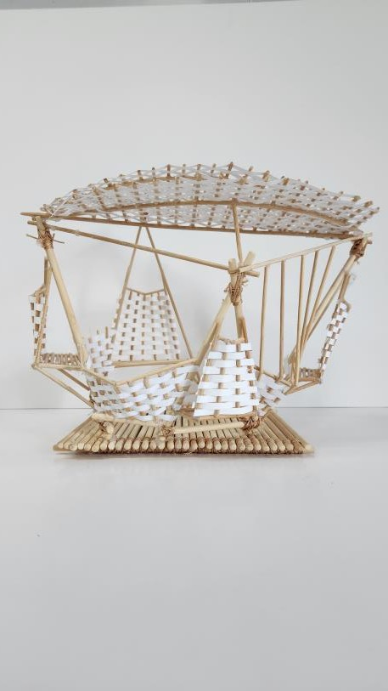
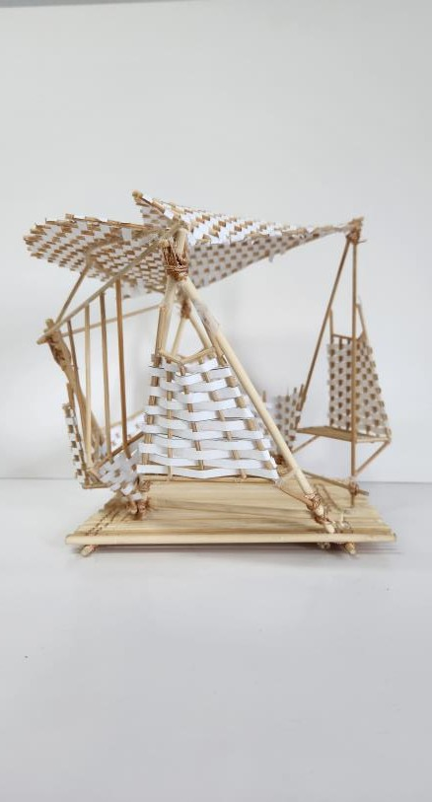
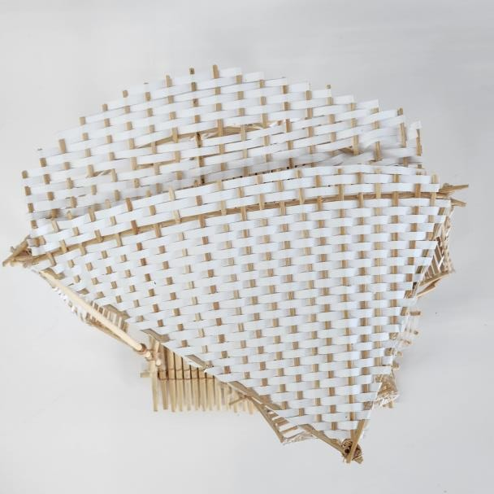
Final Mock Up
Top View
Front View
Left View
Rear View
Right View

Slide 9
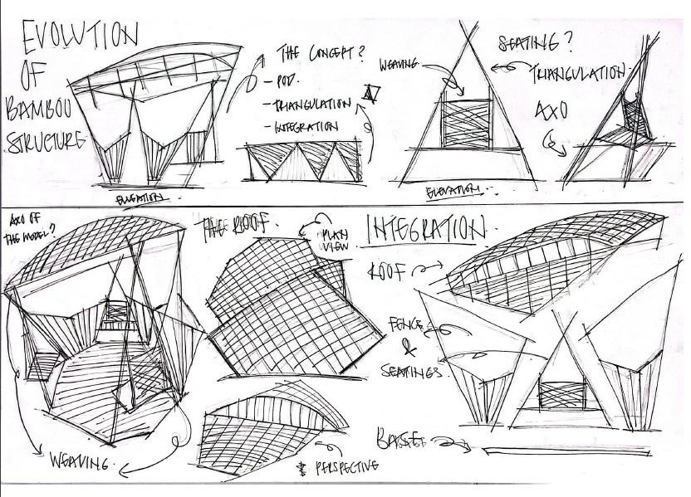
Final Design Sketches
After examining the 2 mockup models, my team and I created one final design, with considerations of the materiality, tectonics, ergonomics, etc.

Slide 10
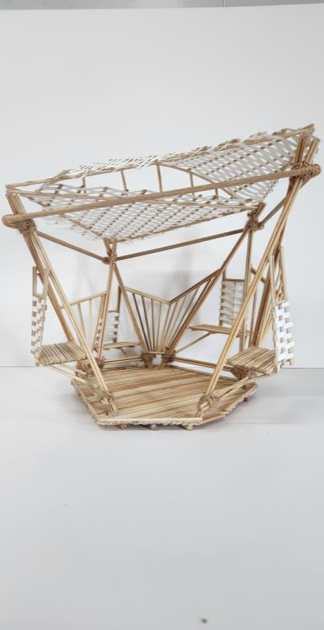
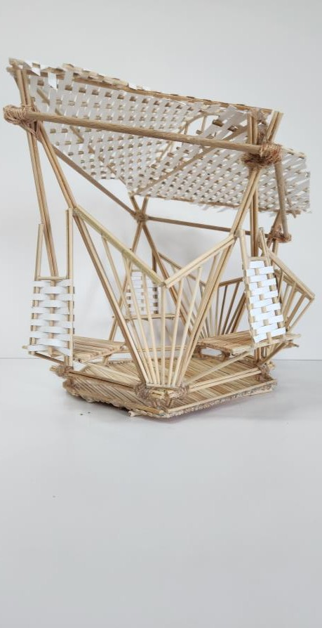
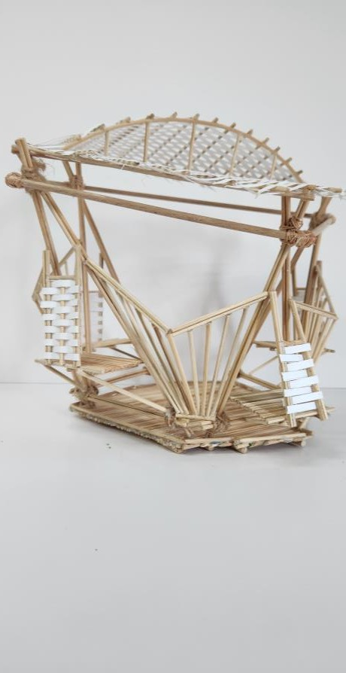
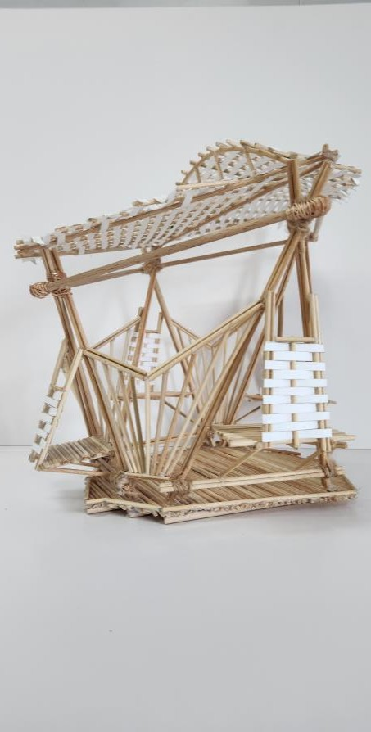
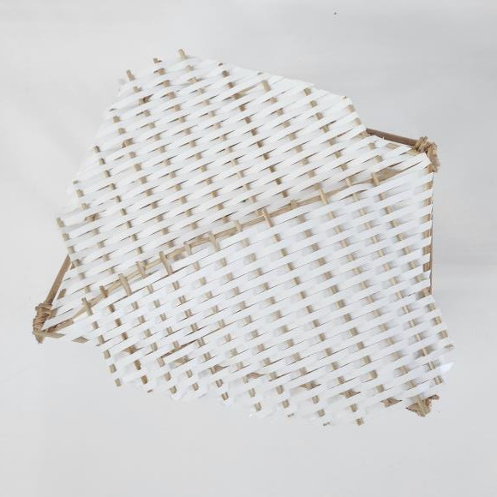
Final Model
Top View
Front View
Left View
Rear View
Right View

Slide 11
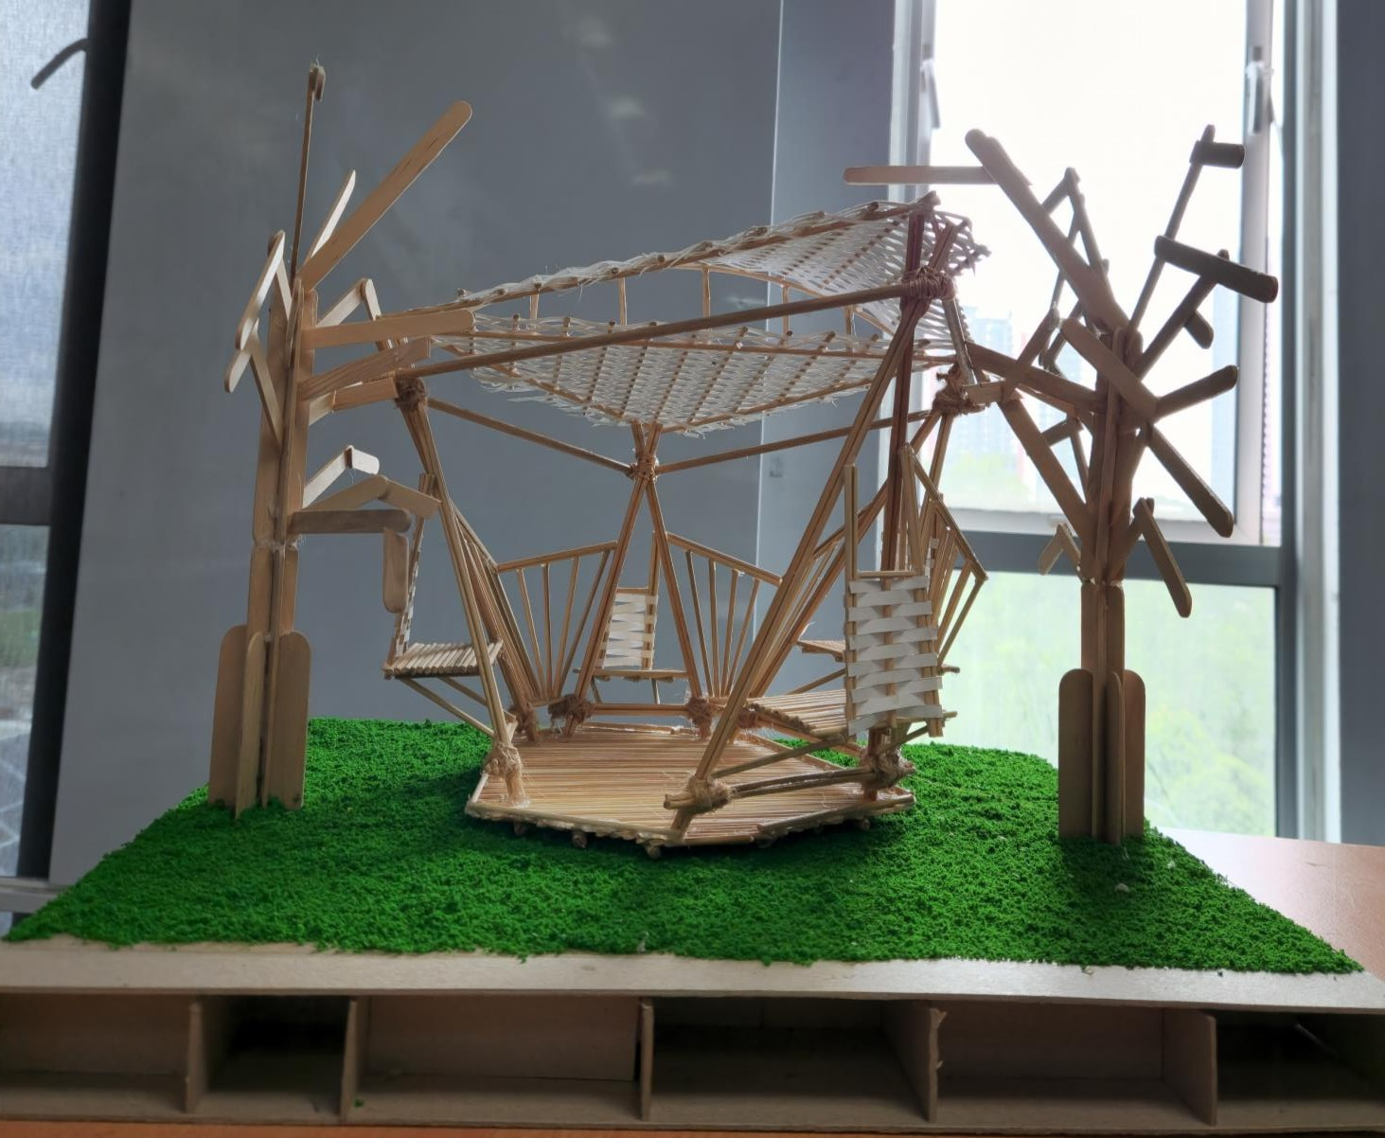
Site Model

Slide 12
Final Structure

Slide 13
